Slide 1
The Hesbora The Gospel
Artificial Intelligence
Presented by Rameez Hassan Raja
References: AL Jazeera news
The GurdianGuardian

Slide 2
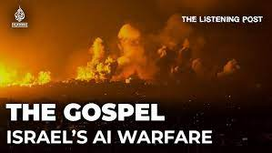
Introduction:
IDF's Website unveils AI system: Habsora
Nicknamed "The Gospel"
Purpose of The Gospel:
Utilized during conflict with Hamas
Efficient target identification
Use of AI:
Habsora as a state-of-the-art AI instrument
Amplifies the frightful nature of warfare
Cutting-edge Technology:
Fusion of advanced technology
Real military operations
Dystopian Imagery:
Evokes imagery from a dystopian film
Prompting contemplation on AI in warfare
Results:
Reflecting on the evolving nature of war
Impact of artificial intelligence in military operations

Slide 3
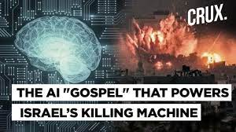
IDF's announcement on Habsora
Rapid and automated intelligence
Extraction provides targeting suggestions
Aims for harmony between machine
recommendations and Human identification procedure
Attaining complete harmony
Balancing machine and human inputs

Slide 4
Platforms like the Gospel enhance IDF's capabilities.
Increased identification and targeting of
lower-ranking Hamas operatives.
Change in strategy revealed by an
official involved in targeting decisions.
Shift in approach: Residences of junior
Hamas members are now considered bombing targets.
Transformation in targeting policy for ongoing conflict
Previously, houses of lower-ranking
Hamas members were not selected as bombing targets
Current approach: Suspected Hamas
operatives' houses targeted regardless of their rank

Slide 5
Former high-ranking Israeli military official
discloses new technique
Precise method for ascertaining the
count of evacuated civilians before an attack
Utilization of an algorithm for evaluation
Algorithm assigns ratings to remaining
civilians: green, yellow, or red
Analogy to a traffic signal system
Efficient and strategic approach to
assessing civilian presence
Balancing military objectives with
minimizing civilian casualties

Slide 6
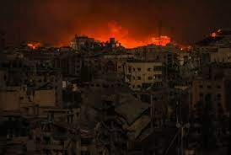
Before the war, IDF used gospel to target 50 members of Hammas per year but now after the war, they are targeting 100 people per day.
Many civilians are killed due to this AI technology System
The implementation of the Gospel has empowered the IDF to detect and eliminate a greater number of Hamas members
Specifically those in lower positions. This system enhances the precision and efficiency of targeting strategies.

Slide 7
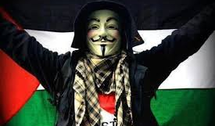
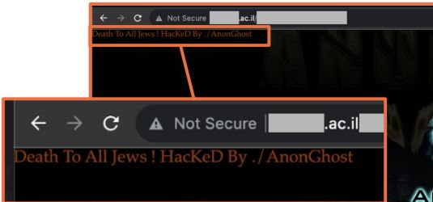
Countering the System of Gospel:
Hacker groups named Anonymous, Anon Ghost and many more is countering these high-tech weapons of Isreal
They had warned Israel to stop geocoding Palestinians.
However, there has been no major attack by these hacker groups.
We have to learn these new technologies to counter these deadly AI weapons.

Slide 8


